Slide 1


Architecture diagram
2018/5/16
The document is disclosed under NDA.
Copyright Thunder Software inc. 2008-2015 All right reserved
http://www.thundersoft.com/

Slide 2
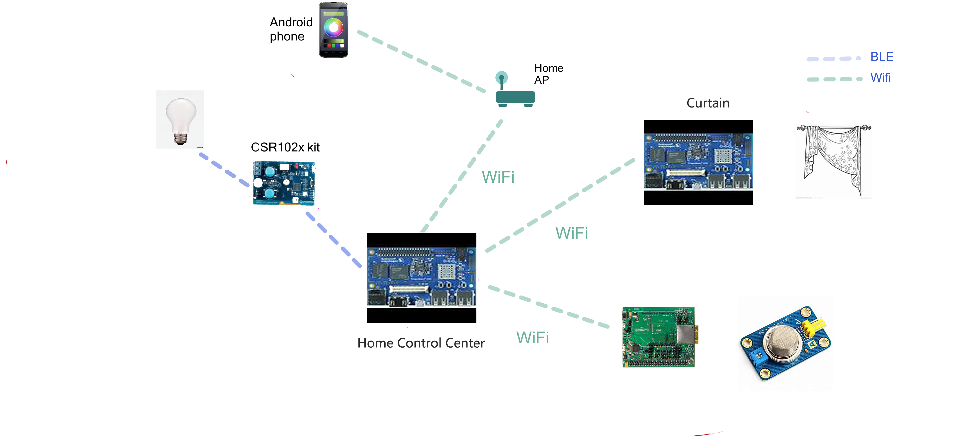

Slide 3


Thank you!
Website:
http://www.thundersoft.com/
Contact us:
biz@thundersoft.com
+86-10-62662686
Address:
4th floor, Taixiang Building 1A#, Longxiang Road, Haidian District Beijing, China, 100191

